Slide 1
Train occupancy prediction
IDLAB
dieter.dewitte@ugent.be Lyon, February 6, 2018

Slide 2
Tuesday Morning Program
9:30 Intro / iRail / Data Prep & EDA
9:50 Setup
10:00 Exploratory Data Analysis
10:45 Recap & Break
11:00 Machine Learning Quick Overview
11:20 Building your first model(s)
11:50 Recap & Tuning
12:00 Final sprint: who has the best model?
12:30 Lunch

Slide 3

Big Data Introduction

Slide 4
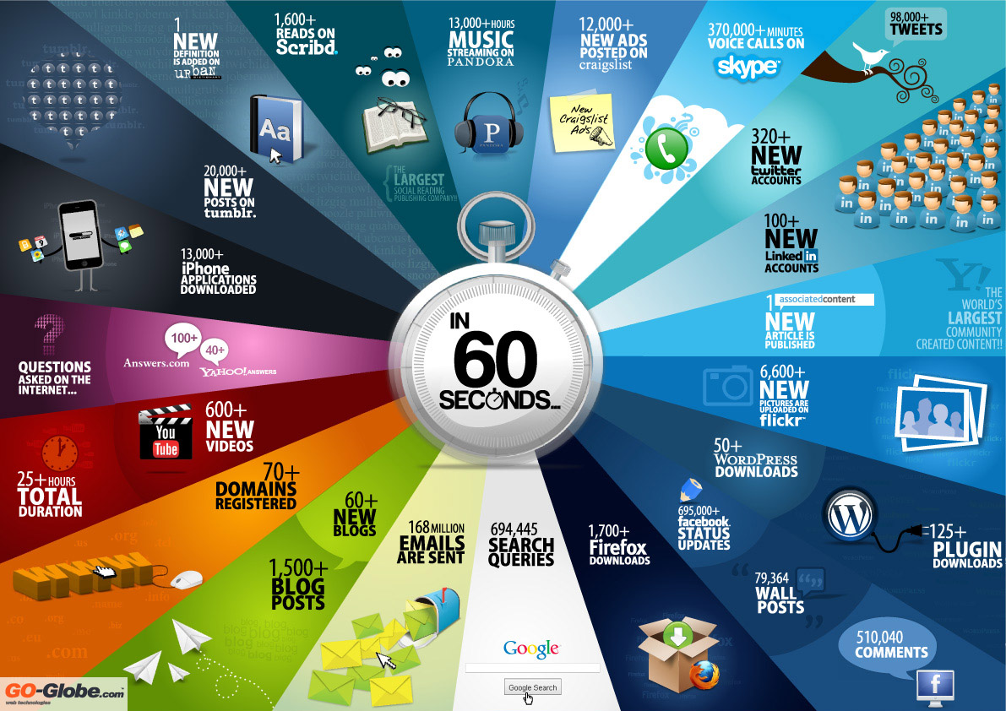
Notes:
Big Data: Data availability has exploded, cf slide, and at the same time the tools to analyse these have become better. This completes the circles as it motivate more data publishing at higher rates, more use cases pushing the Big Data frameworks even further
What has changed? There has always been data (cf. speaker at Winterschool Taragona). But now a little miracle has happened. Data generation has exploded but

Slide 5










User behavior = big data
Notes:
Amazon: recommender systems analyze your click and buy behavior, try to put you in groups (collaborative filtering), Paypal analyses your transactions
Multimedia consumption: Netflix recommendation systems, Spotify tries to generate personalized playing lists based on your behavior
Personal health: eating (weight watchers), Runkeeper sports behavior,
Online Gaming
Social media and QA systems, LinkedIn for jobs…

Slide 6
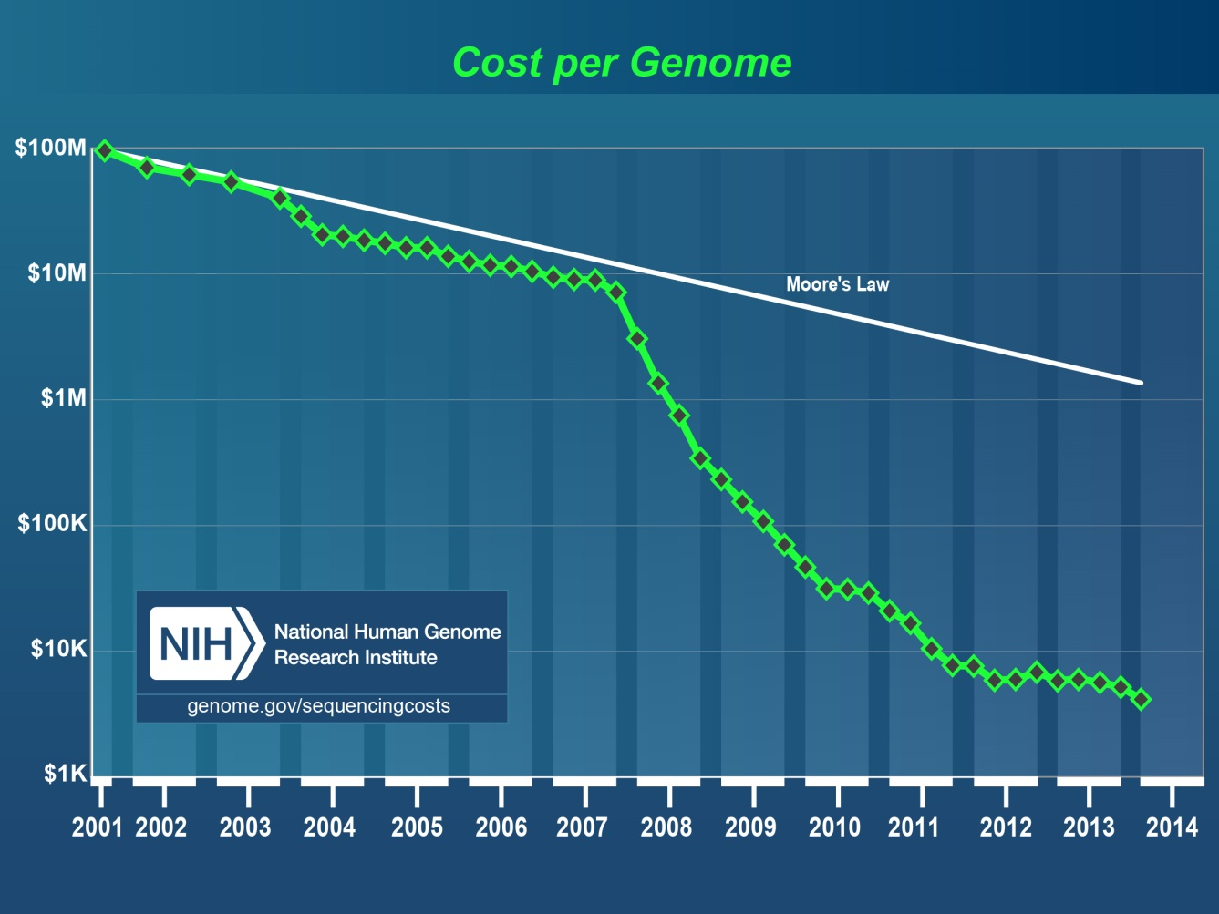
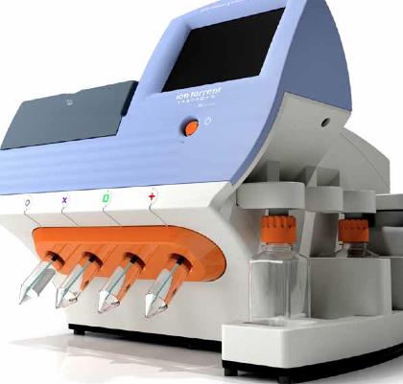
Users themselves are data sources…
Notes:
The cost of the sequencing and assembling the first human genome has dropped from $100million dollar to roughty 1000$, making it affordable for use in hospitals. Drops faster than moore’s law.
Data processing is however not trivial. A sequencer typically works with multiple copies of the same DNA, which is shattered to pieces of roughly 100bp which have to be assembled / mapped to form the entire 3Gbp human genome. Talk in recent Spark Summit a colleaugue of Ghent University showed to enormous impact in veterinary sciences (less ethic issues!)

Slide 7
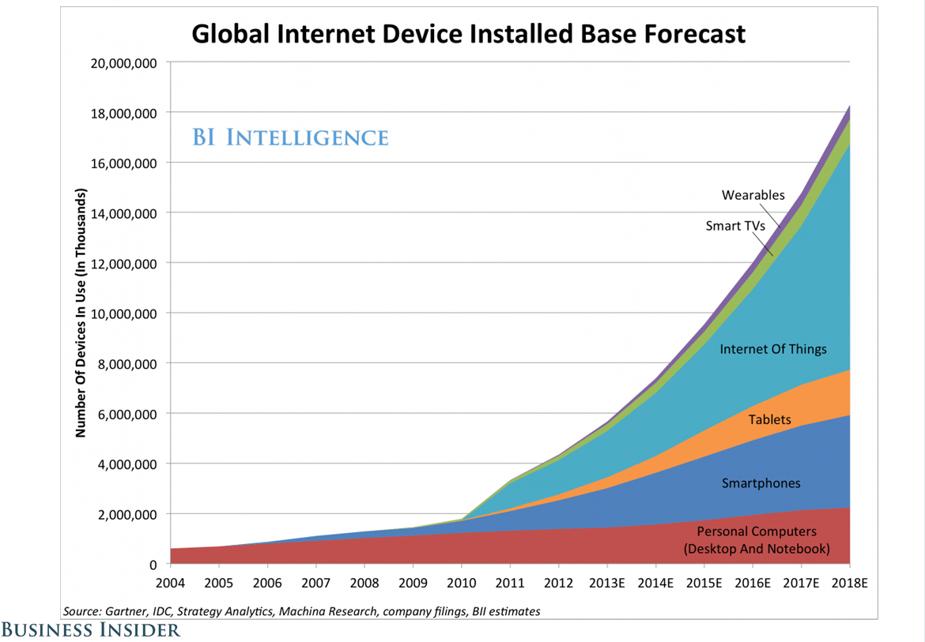
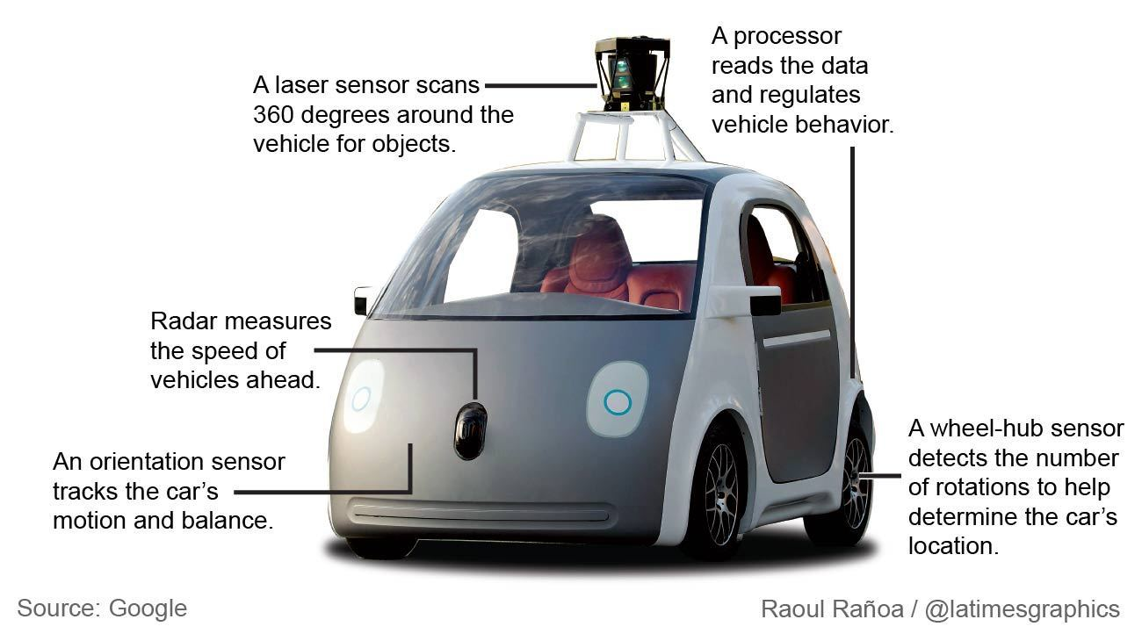
Devices push data generation
Notes:
The number of connected devices is skyrocketing. New products like connected cars will lead to an even higher number…

Slide 8
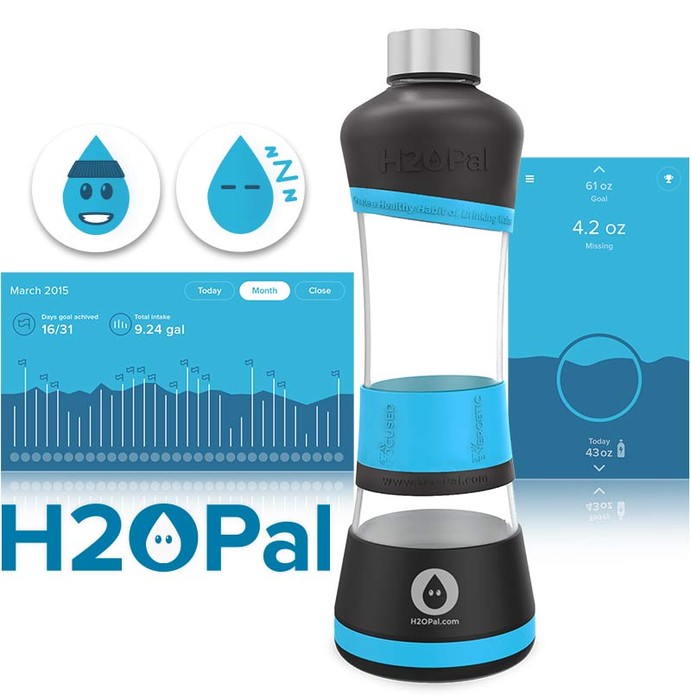
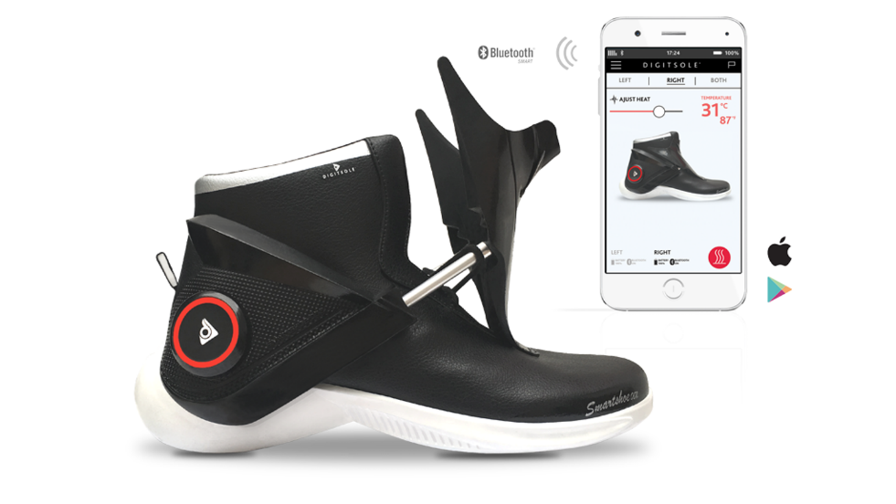
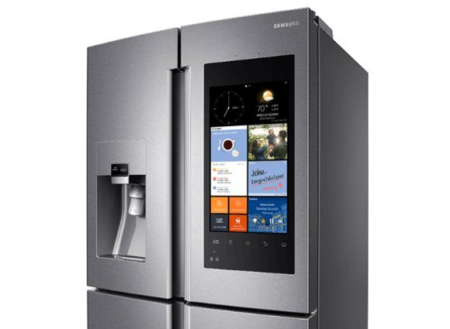
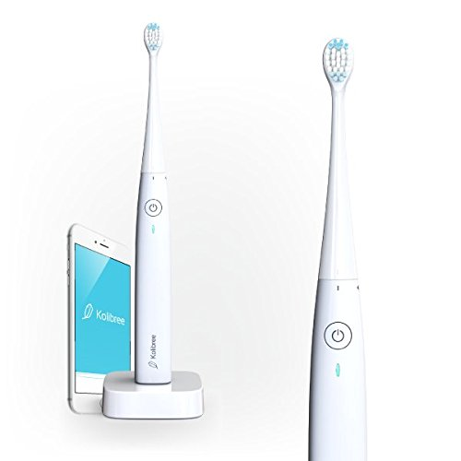
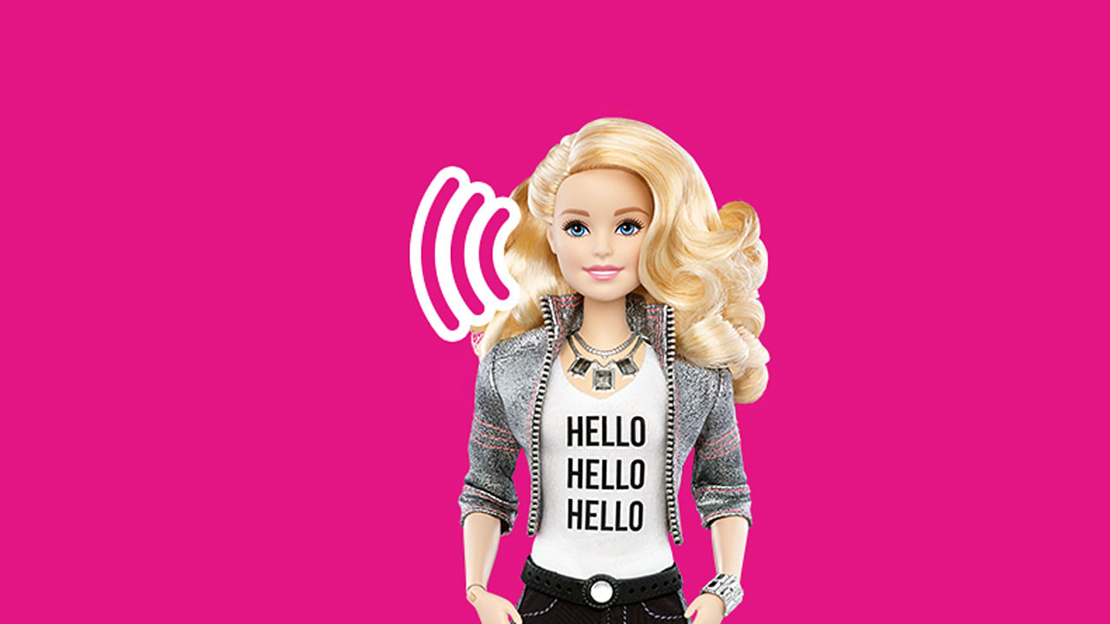
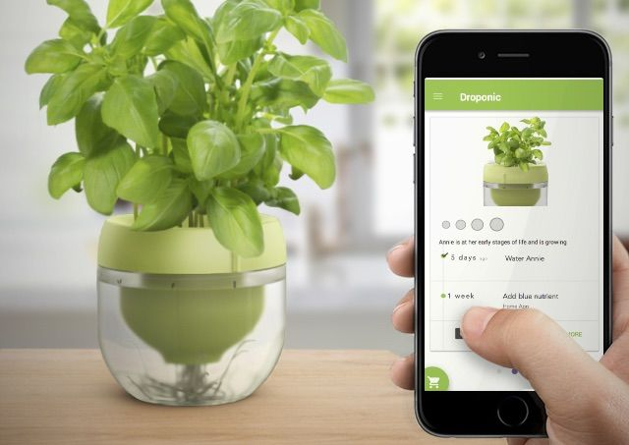
In case you aren’t convinced yet…
Notes:
Really, although it might be a bubble people would like to connect everything to the internet…. Even your water bottles, your tooth brushes, your shoes and your daughter’s Barbie doll…

Slide 9
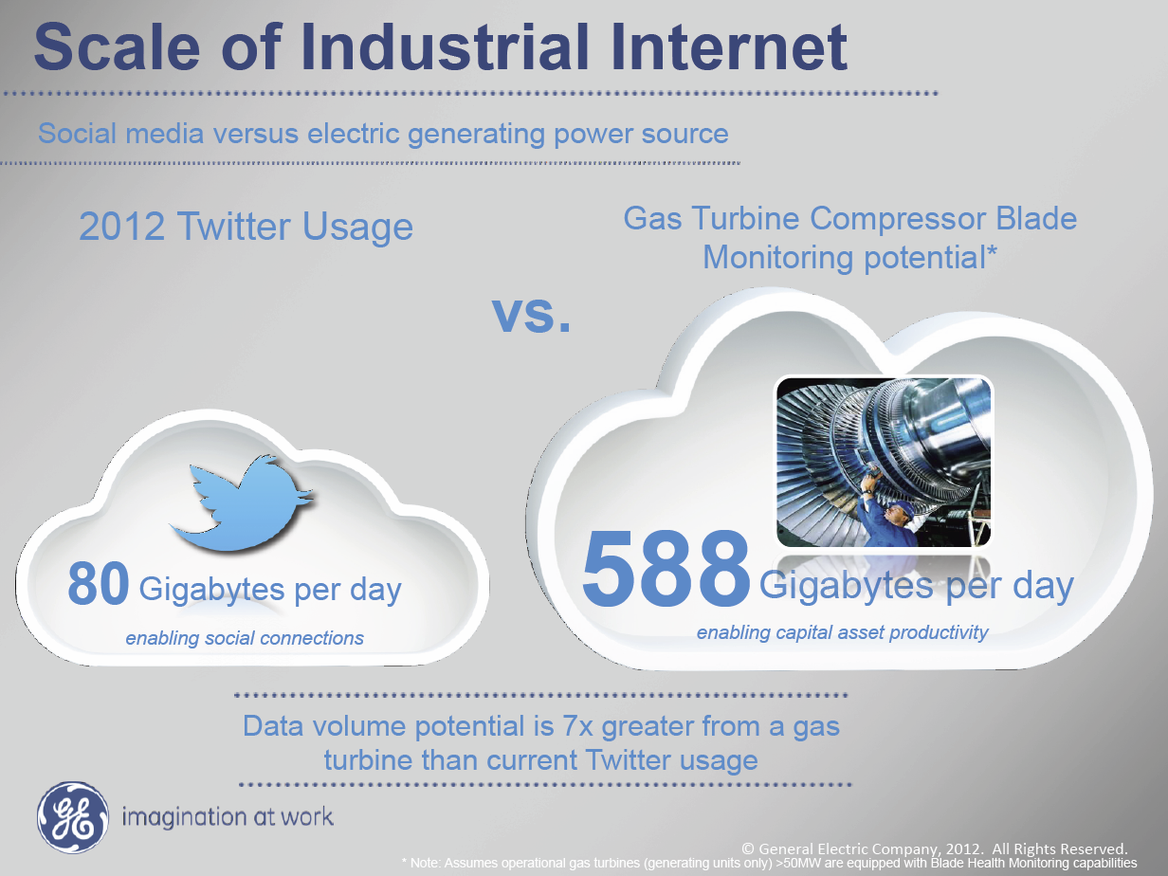
Industry 4.0
Notes:
If you think Social Media is generating a lot of data you ain’t seen nothing yet. In January Sofie will supervisor of a Phd collaboration with Arcelor Mittal. The sensors they put on their machinery typically generate 1000 events per second. We already worked with data from a single pipeline (coldmill) which has over 200 sensor installed.
Assume 100b per event => 100 x 200 x 1000 b per second => 20 MB per second, 1 GB per minute => 1 TB per day. In practice you can work with downsampled data, for example store one event per second for most sensors but still….

Slide 10
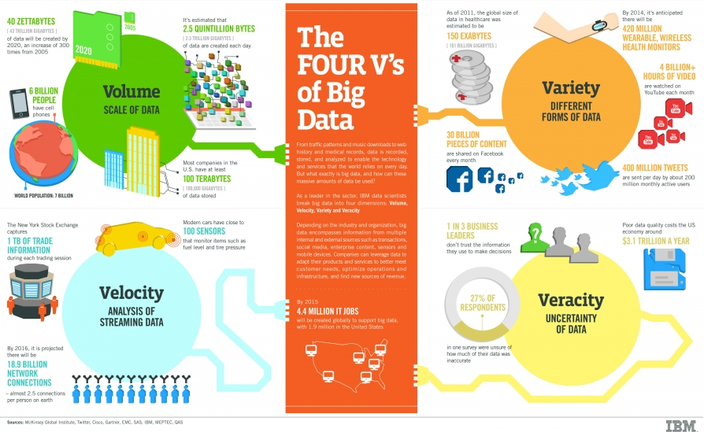
not just ‘my Data is bigger than yours’…
Notes:
In most use cases in fact velocity (=latency) will be more challenging, think IOT for example. Data quality = veracity (example Telenet => no data quality checks data is almost unusable), variety: the data publisher doesn’t worry about the data scientist!

Slide 11
Train occupancy prediction

Slide 12
spitsgids
w : A crowd-funded project in 2016 led by iRail and TreinTramBus
Question:
“How can we avoid busy trains?”
Idea: Motivate people to take another train by informing them about train occupancy beforehand.
Solution: Add a module to iRail to measure train occupancy

Slide 13
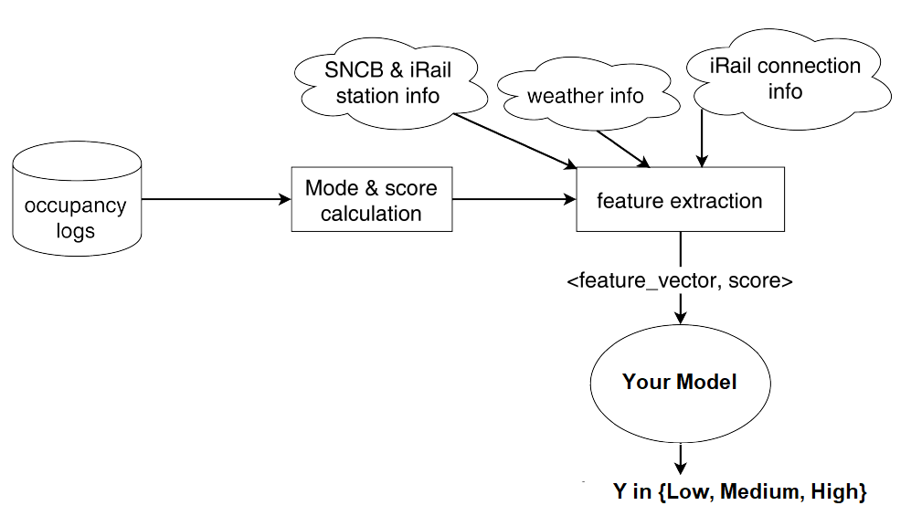
Your Mission: build a winning model
https://www.kaggle.com/c/lyon-train-occupancy

Slide 14
Data Preparation & Exploratory Data Analysis

Slide 15
The data science process (iteration)
Source: Introducing Data Science – Davy Cielen - Manning
Notes:
Building a model is a long process though. The modeling part is in fact only a small fraction of this process. Often this process involves loops! Model evaluation might inspire you to look for extra data, which has to be retrieved, cleansed, prepared

Slide 16
understanding the data domain (1)
What is contained in the Query Logs?
Notes:
Note: departure and arrival is defined by the query of the user!

Slide 17
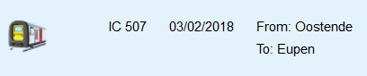
Understanding the data domain (2)
What ‘features’ can we extract from the query time?
What does the Vehicle ID say?
Vehicle Types: L, IC, P,… (IC = InterCity)
500 Train Series (Oostende -> Eupen)
7: is the sequence number (7:32 → 10:43)
Seq nr. +25: Eupen -> Oostende!
http://www.belgianrail.be/en/
https://nl.wikipedia.org/wiki/Treincategorie%C3%ABn_Belgi%C3%AB
Notes:
Query time can be converted into many features? School holidays, weekend, day of the week, rush hour, be creative!!
The Vehicle ID encodes some information as well!

Slide 18
data Preparation: Why & How?
Attributes
Machine Learning Algorithms require:
A dense dataset in m x n matrix form X
m Rows = data objects
n Columns = different attributes
Column values = numerical (!)
Supervised ML algorithms require a label vector Y
How to?
How to make the data tabular?
Preprocessing of non-tabular data formats, (ex.: JSON)
Make all attribute values numerical?
Categorical Data Transformation
Label Encoding: {Yes, No} → {0,1}
One-Hot-Encoding {Single, Married, Divorced} => {[1,0,0],[0,1,0],[0,0,1]}
Improve matrix quality
Missing data imputation: NaN => average or drop
Removing near-duplicate data: averaging
Numerical Scaling to improve learning algorithm performance: {125k, 100k, 75k} => {1, 0,8, 0,6} (min-max scaling)
Are columns independent? Can we remove some?
Objects
Notes:
Interactie: wat zijn voorbeelden uit het data domein?
* json dataset
* categorical data: IC, IR, S,..,
* Label encoding: low, medium, high occupancy => 0,1,2
* scaling, bijvoorbeeld minutes from midnight => [0,1],
* feature selection: uur van de dag of iets meer betekenisvoller, is dit catorisch of continu?
* duplicates: wat als 2 mensen op dezelfde trein een verschillende occupancy waarde meegeven?
* Is het verstandig om uur van de dag en minutes from midnight allebei te gebruiken?

Slide 19
Understanding the data with eda
Do we really need a Machine learning algorithm!?
“Seeing is understanding”
Humans are quite capable of performing visual pattern recognition!
Methods for Exploratory Data Analysis:
Summary Statistics: mean, median, range, variance,..
Visualization: histograms, boxplots, scatter plots, correlation plots
Notes:
In het notebook zullen we de data op veel verschillende manieren bekijken, je zal merken dat je een veel beter inzicht krijgt en dat er snel inspiratie zal komen om features te maken

Slide 20
Hands-on: Setup & EDA

Slide 21
Setup your local (big Data) environment
ssh-client (www.putty.org)
Connect to imec cloud
Per 2 you’ll get Ubuntu VM
Pre-installed with docker
Connect via putty to <IP, pwd>
We’ll use a docker image:
https://github.com/jupyter/docker-stacks
Learn more about docker:
https://github.com/wsargent/docker-cheat-sheet
All course material @ <TODO>
Lyon_Installation.docx
Download/Upload data from Kaggle site
First notebook: <TODO>
NOTE: This slide deck is also in the GitHub Repo
Have a look at the pandas cheat sheet

Slide 22
EDA: Recap
Notes:
Vraagje: hoe zit het met de distributie van de class labels => wat impliceert dit? Wat is de minimale accuracy dat een algoritme moet halen, 33% of iets meer?
Verder: interactief door notebook gaan zodat iedereen wat kan aanvullen

Slide 23
Machine learning: quick overview

Slide 24
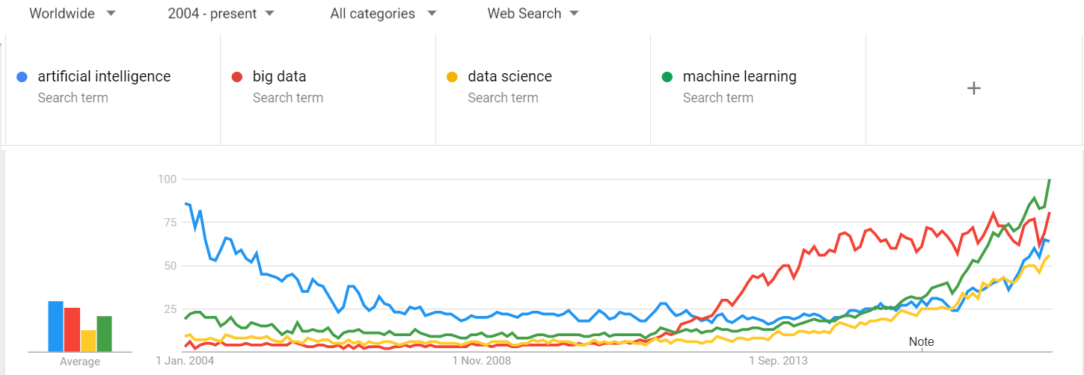
Battle of the buzzwords
Google Trends
Notes:
The terms each have their own definition but they are used mainly by people not aware of the differences. So nonoverlapping could be that A.I. also contains, search & reasoning, big data puts a lot of attention to data management, data science is both statistics, BI,.. (the latest buzzword, machine learning is the most precise as it describes a set of learning algorithms which have some common characteristics: train/test, cost functions, validation,…
Let’s focus on machine learning

Slide 25
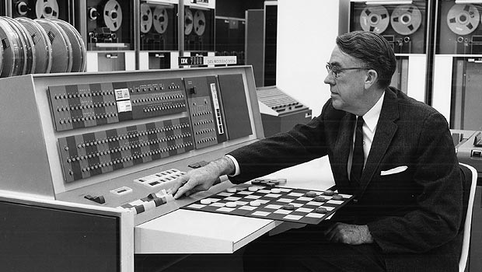
So what is machine Learning?
Definition: (Arthur Samuel, 1959)
ML is a field of computer science that gives computers the ability to learn without being explicitly programmed
Notes:
What strikes you the most on this slide? (1959!!)

Slide 26
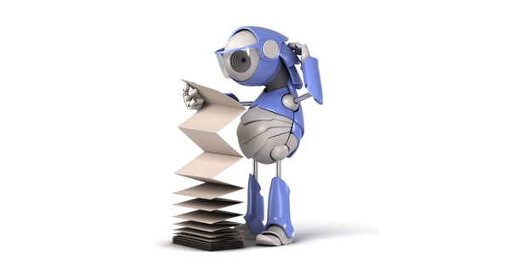
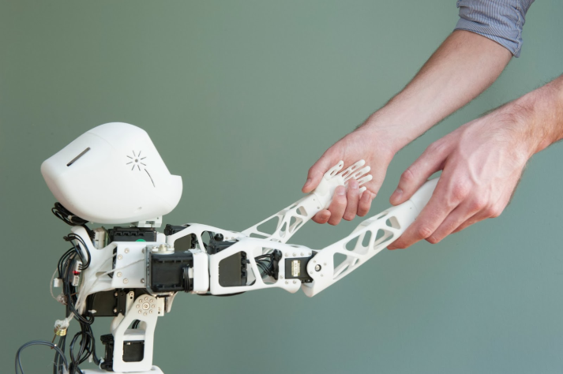
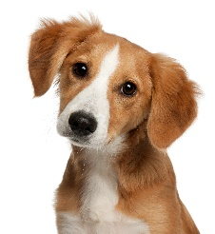
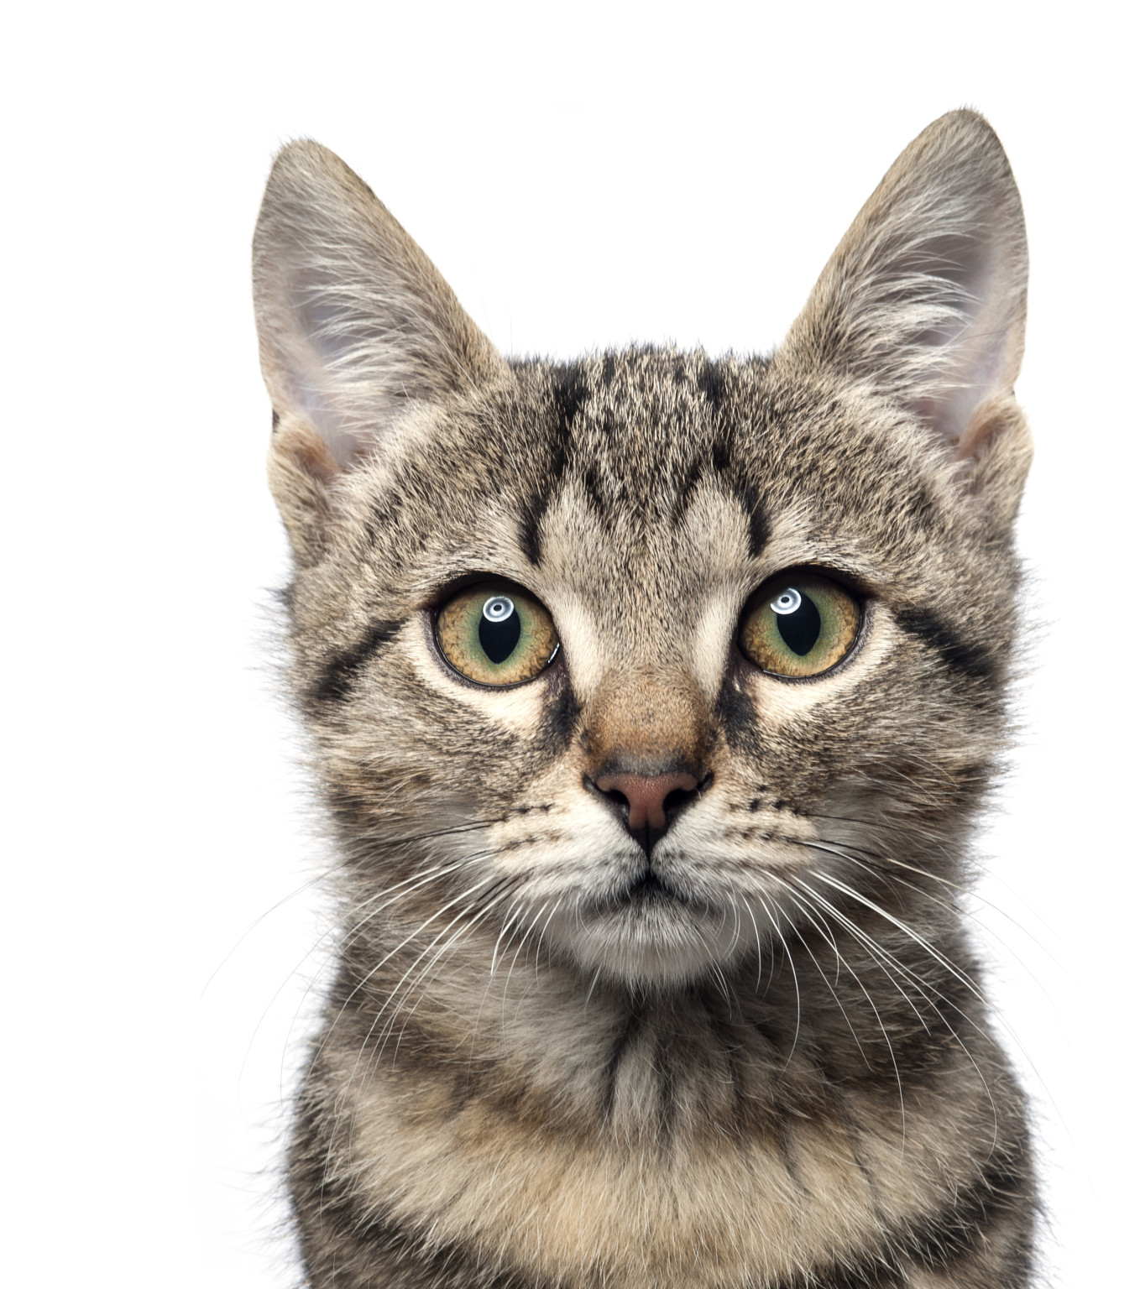
Learning algorithms
Supervised Learning
(= learning from labeled examples)
Unsupervised Learning
(= learning from non-labeled examples)
dog
cat
Notes:
Note there are also in between => semisupervised learning when part of the data is labeled

Slide 27
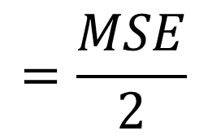

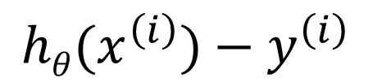
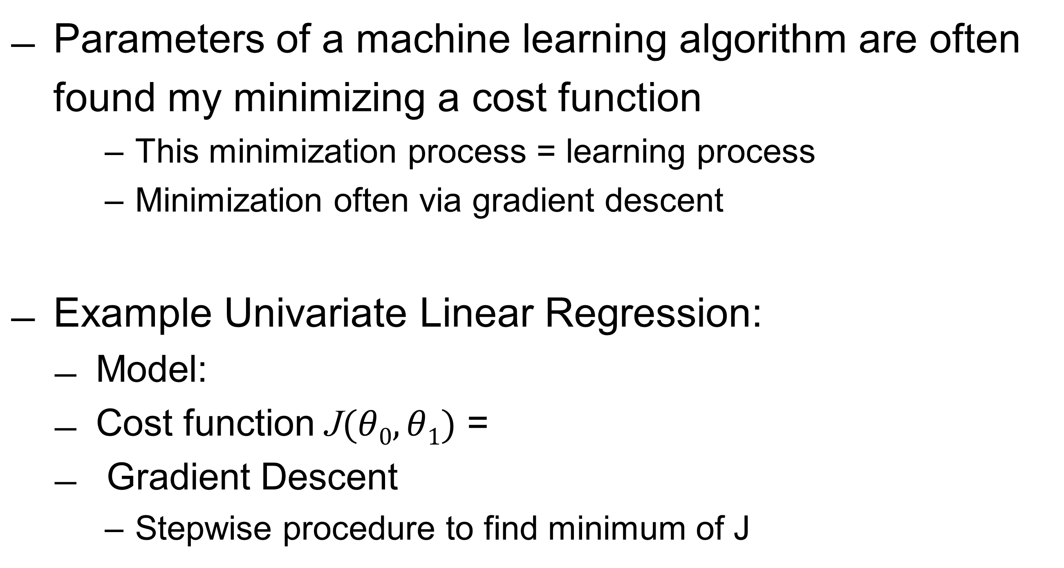
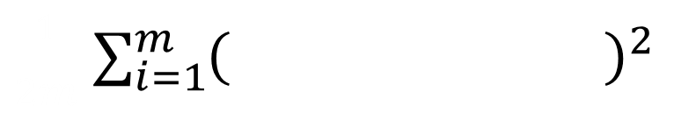
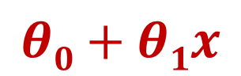
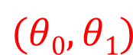

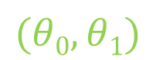
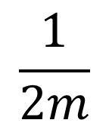
What is learning?
Parameters of a machine learning algorithm are often found my minimizing a cost function
This minimization process = learning process
Minimization often via gradient descent
Example Univariate Linear Regression:
Model:
Cost function J$(θ0,θ1)$ =
Gradient Descent
Stepwise procedure to find minimum of J
$$(θ0,θ1)$$
$$(θ0,θ1)$$
$$(θ0,θ1)$$
$$hθ\left(x\right)=$$
$$θ0+θ1x$$
$$\frac{1}{2m}$$
$\frac{1}{2m}$ $\sum_{i=1}^{m}{{\left( \right)}^{2}}$
$$=\frac{MSE}{2}$$
$$hθ(x^{\left(i\right)})−y^{\left(i\right)}$$

Slide 28
Supervised learning
Regression
Y is continuous
Ex.: predicting housing prices
Classification
Y is categorical
Ex.: tumor is benign/malignant
Price ($)
in 1000’s
1 (Y)
Malignant?
0 (N)
Size in feet²
Tumor size

Slide 29
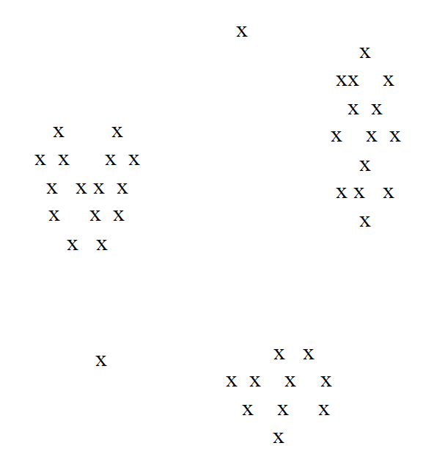
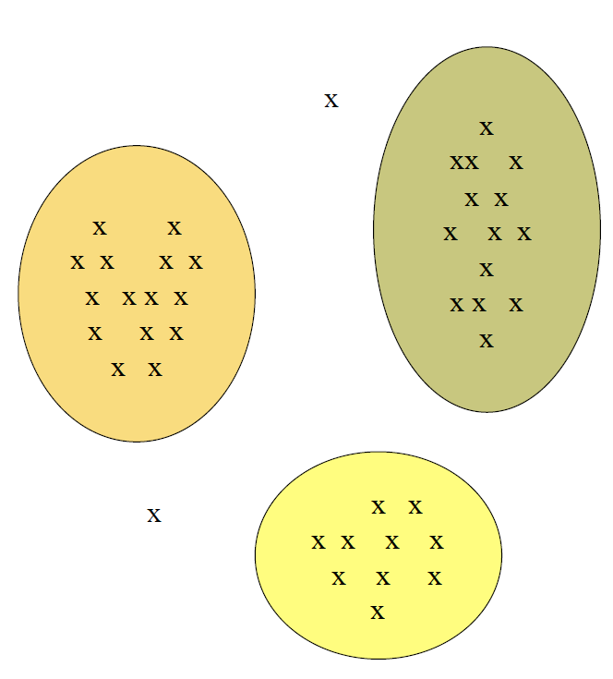
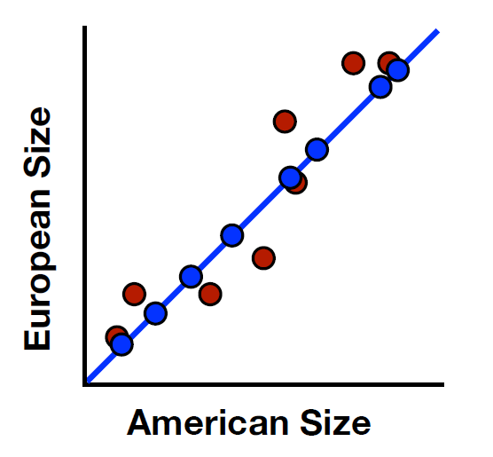
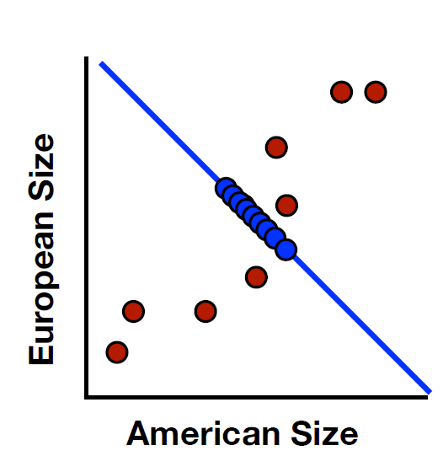
Unsupervised learning
Clustering
Distance metric d
Cluster:
p, q in same cluster d(p,q) small
p, q different cluster d(p,q) large
Dimensionality Reduction
Curse of dimensionality:
in high dimensional spaces almost all p,q are at the same d
Projection:
on a lower dimension with minimal information loss

Slide 30
Which of these Machine Learning types
do we need for occupancy prediction?
Notes:
Classification with 3 classes: low/medium/high

Slide 31
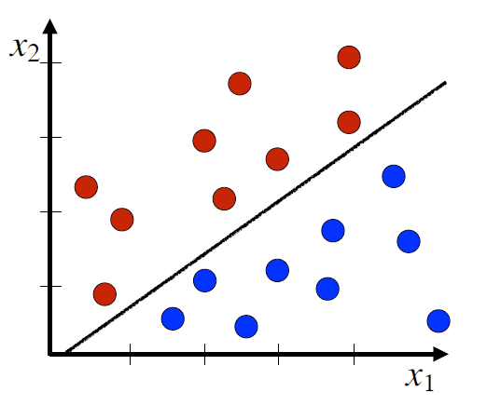
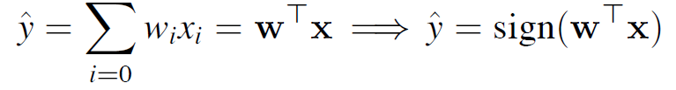
Classification zoo: logistic Regression
Find the parameters w which..
… separates 2 classes
Decision boundary:
Returns class probabilities: P[y=1 | x] = sigmoid( )
Notes:
Is het ook mogelijk om bijvoorbeeld een circulaire decision boundary te verkrijgen?

Slide 32
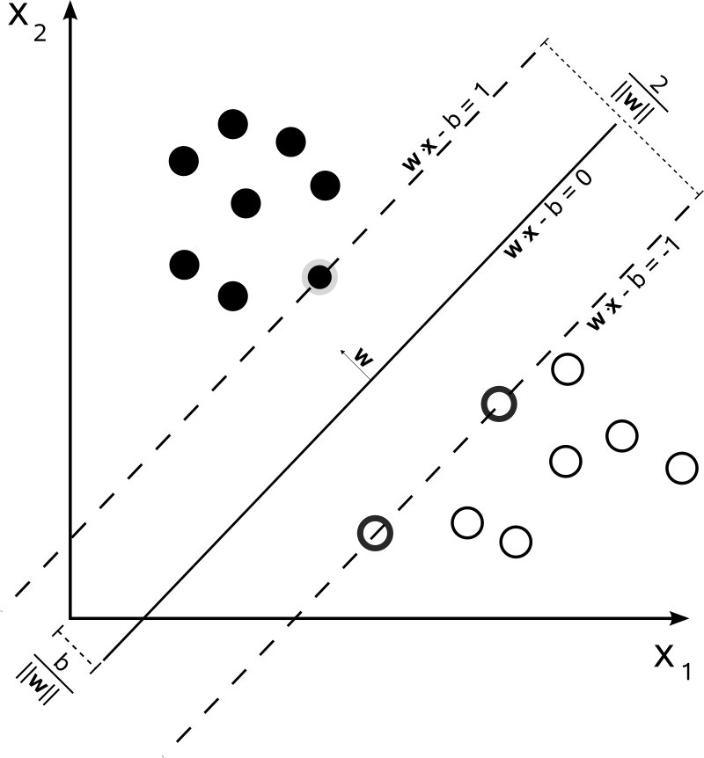
zoo: SVM
Support Vector Machine
is a learning algorithm that tries to find the optimal decision boundary
Optimal:
maximize the width of the ‘gutter’ b (support vectors)
Distance = kernel(x,y)
Often Gaussian, but kernels for many cases exist:
String kernels
Graph kernels
…
Notes:
Has long been the most performant classification algorithm, neural networks currently outperform SVMs quite often, but we will skip those since they will be the topic of this afternoon’s lecture. Decision boundaries zijn soms complex, met logistic regression betekent dat dat je hogere orde polynomials moet gebruiken maar dat leidt al vrij snel tot problemen, SVMs hebben daarom

Slide 33
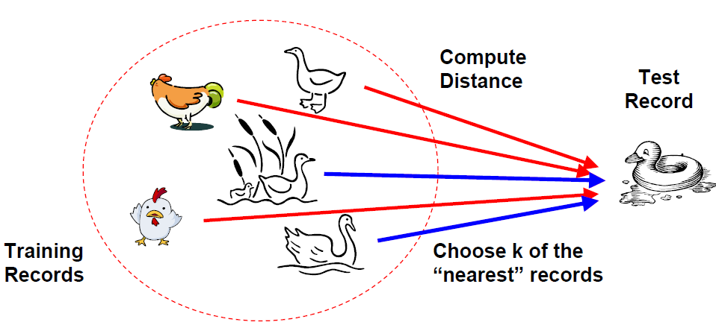
Zoo: Instance-based learning
Classify by memorizing training data and use k most ‘similar’ items to vote on class label (k nearest neighbours)
“If it walks like a duck, quacks like a duck, then it’s probably a duck”
Drawback:
Curse of dimensionality
Many distances to calculate!

Slide 34
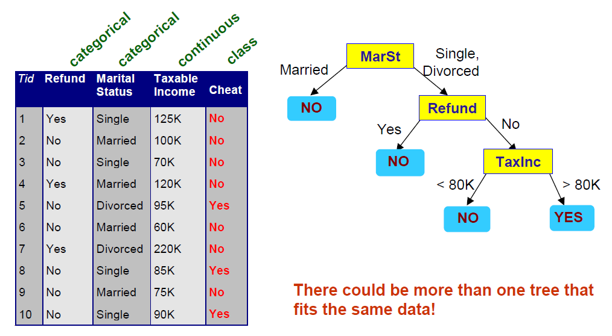
Zoo: decision trees
Greedy (top-down) algorithm that tries to split the data based on an attribute test in order to optimize a purity criterion
Impurity:
Gini index
Entropy
misclassification error
++White box model!
-- Overfitting issues

Slide 35
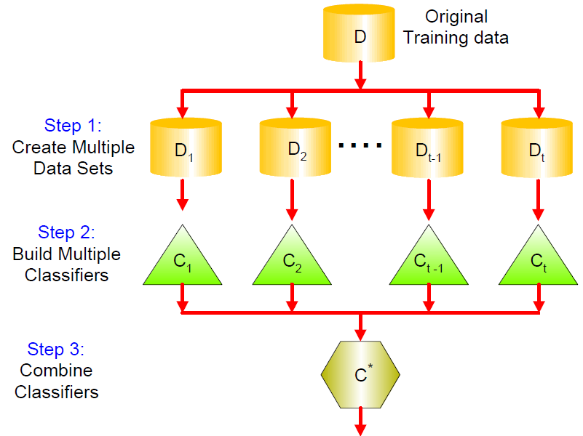
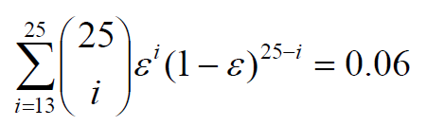
Zoo: ensemble methods – random forest
Decision Trees are sensitive to overfitting (greedy strategy)
What about training multiple trees?
Each tree has
a subset of the data
a sub selection of the features
Idea
Suppose we have 25 independent trees with error rate 0.35
Esemble error rate:
Notes:
Ook interessant =>

Slide 36
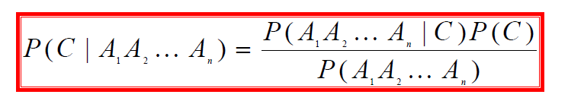
Naive Bayes
Which class C has the highest probability for a record with features A1,… An?
How to estimate P(C | A1, A2,.. An)?
Bayes Theorem!
Naïve? P(A1, A2,…An | C) = P(A1 | C) * P(A2 | C) * …
Notes:
We assume independence between A, definitely for NLP cases this is not the case

Slide 37
Build your first model(s)

Slide 38
Have a look at sklearn cheat sheet

Slide 39
Recap & tuning

Slide 40
Diagnostic I: bias vs variance
Learning curves shows the evolution of the train and test error as a function of training set size
BIAS: model is too simple VARIANCE: model is overfitting => bigger m or less features

Slide 41
Diagnostic II: Model convergence
Plot the cost function as a function of the number of iterations of the learning algorithm

Slide 42
Diagnostic III: ablative analysis
For complex ML pipelines with many sub-components we may want to investigate how much does each part add to the overall performance?
Ablative analysis: remove one component at a time and measure effect on system accuracy

Slide 43
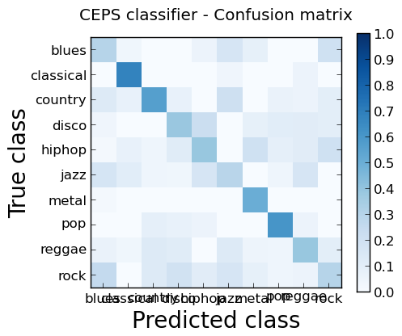
Diagnostic IV: confusion matrix
Comparing predictions to actual class labels
Where did my algorithm get confused?
improvement!
Figure on the right:
Jazz is hard to identify
Rock and blues are often mixed up
Notes:
And apart from that… be creative, make your own diagnostics!

Slide 44
Final sprint

